Slide 1
L T M : Local Travel Mate
Final Project Presentation
Team: United UK
Members:
Abdullaev Farkhodjon
Erkinov Habibilloh
Namwoo Kim

Slide 2
Contents
Description of the Project
Objectives
System Structure
Tools and Techniques
System Analysis
Implementation and Results

Slide 3

Local Travel Mate
Nowadays, millions of tourists from diverse countries usually are making travel to different countries every year for different purposes. Most of them go somewhere for study, business purposes, tourist attractions, nature beauty and so on. However, everytime being a foreigner is not easy and almost every time huge amount of travelers face some problems due to transportation, language barrier, hotels, foods, travel infos, tourist attractions, restaurants and so on when they visit to some country as a guest. Based on tourists’ requirements, we decided to make an application(LTM) for travelers to reduce their barriers when they visit to some country.

Slide 4
Description of LTM
At first we were planning to make an application that serves for the tourists who are making a travel for the first time to Some country and do not have any touristic information about the country. Most tourists want to meet local friends during their traveling and know how the locals enjoy their time and culture in their daily life. Locals also wanna meet foreigners. Tourists who use our application will have the opportunity to have a personal guide who know well about touristic places or we also planning to implement some tourism infos and tour plans to our application which can be very helpful for them who do not need any guide. We will be providing service for both guides and tourists, by using our application if someone who have knowledge about touristic places can register to our application and serves to the customers.

Slide 5
Objectives
The main purpose of this application (LTM) is to build a bridge between the locals of host countries and the tourists who are traveling all around the world. Nowadays, most countries are paying much of their attention on the development of tourism and involving immigrants for their countries in order to diffuse their culture and history of their development all over the world. However, sometimes it is a little difficult for some people who wants to travel to some country due to suffering from some kind of problems like not having enough information about the country that they want to visit and not having any acquaintances there. In addition, there is also a problem among some counties’ locals to meet and make foreign friends in their host countries because not having such kind of communication tool that is attached only for tourists and locals. After consideration all of this condition we started working on our project which can be a kind of solution for this problems.

Slide 6
System Structure
Local Travel Mate (LTM) has several useful functions those can be handy for the users like country select and get information function, users’ post board, pick up travel schedule and chat activity. People who are going to travel to some country can use our application as a tour guide by selecting the country that they want to visit and get all informations about the country like the culture of the country, language, tourist attractions, hotels, foods and so on. And also they will be able to meet some friends from that host country that they want to visit by using the chat function of the application. And they can post latest news or updates from their trips to some country or involve other foreigners to their country by posting the most common tourist attraction places to the news board.
User Authentication
Country Info
User Post Board
Pick up Travel dates
Chat function

Slide 7


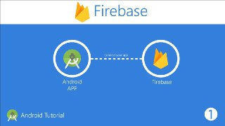
Tools and Techniques
Android Studio
Java Programming Language
Firebase Non Relational Database
Database Structures
Messaging Protocols

Slide 8
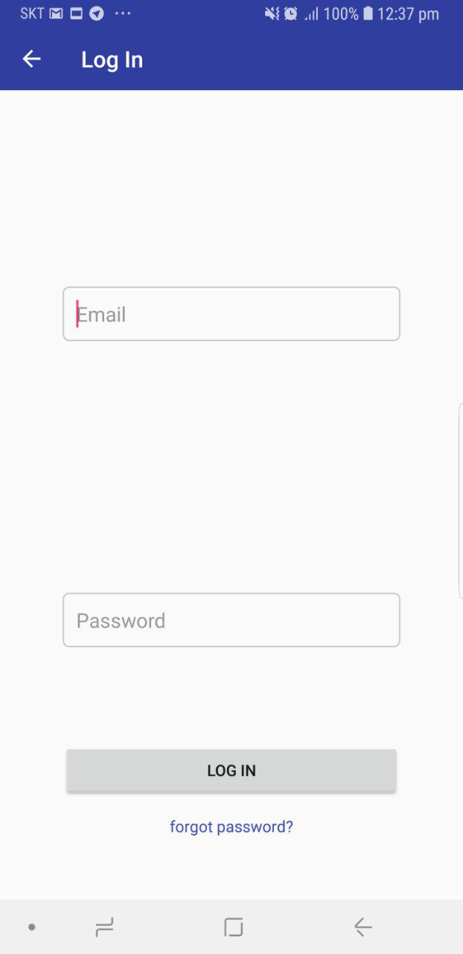
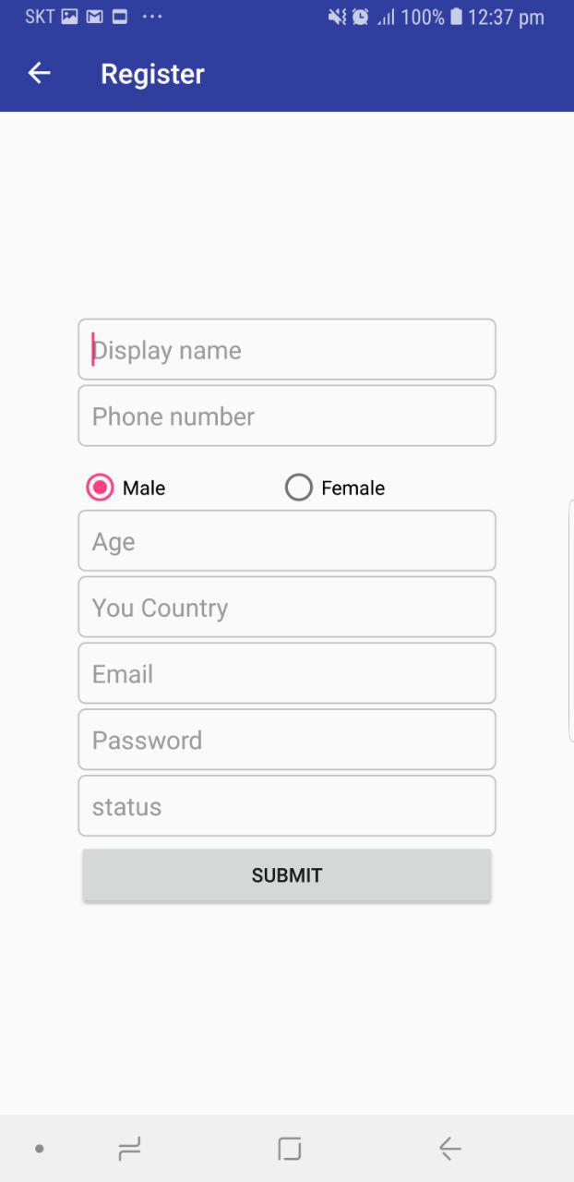
Implementation and Results
As you can see in figure 1, we provide authentication for our users and also to to prevent unauthorized user from accessing database and important personal informations.
Figure 1: Log In and Register

Slide 9
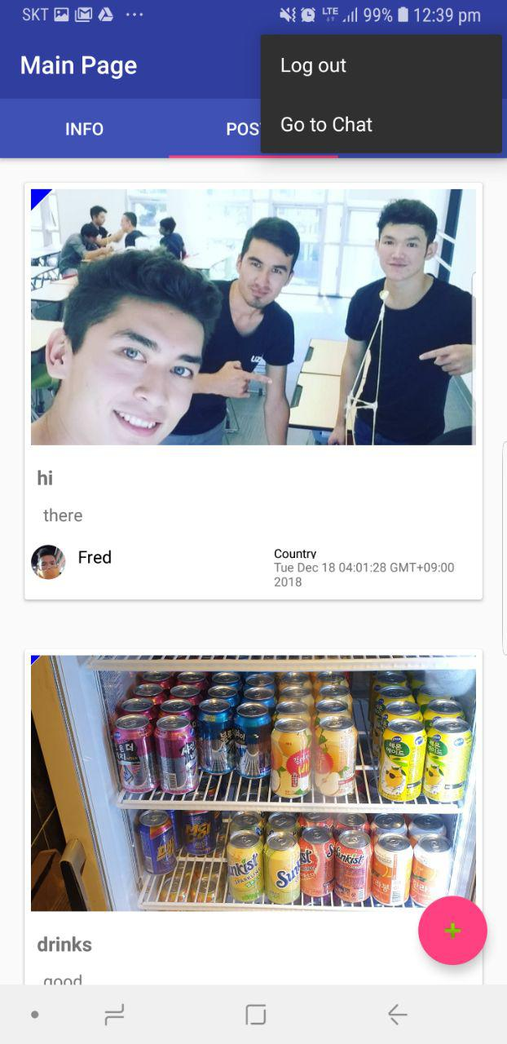
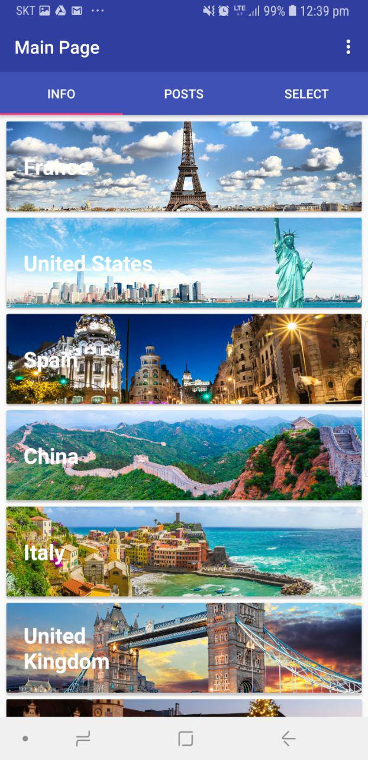
Flow of Functions
In Figure 2, you can see post page and informations page which are created for user to upload posts and find some interesting informations.
Figure 2: Posts and Info

Slide 10
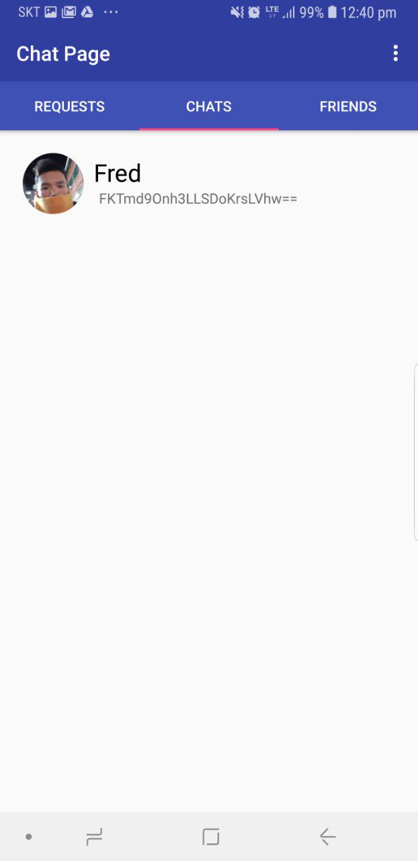
Chat page is one of the most useful facilities for users which have been provided by this application. Chat page has three fragment inner pages which are requests, chats and friends pages. If a tourist or host find some useful information on board page, they can easily contact with the person who upload the post by sending friend request to him or her. If request is accepted they will be added friend lists of each-other. Then they can open chat room and communicate.
Figure 3: Chat Page

Slide 11
Thank you for your attention

